Slide 1
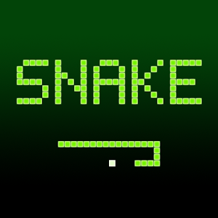
Snake
By Julia Abbott, Alex Blair, McKenna Galle, Eben Schumann

Slide 2

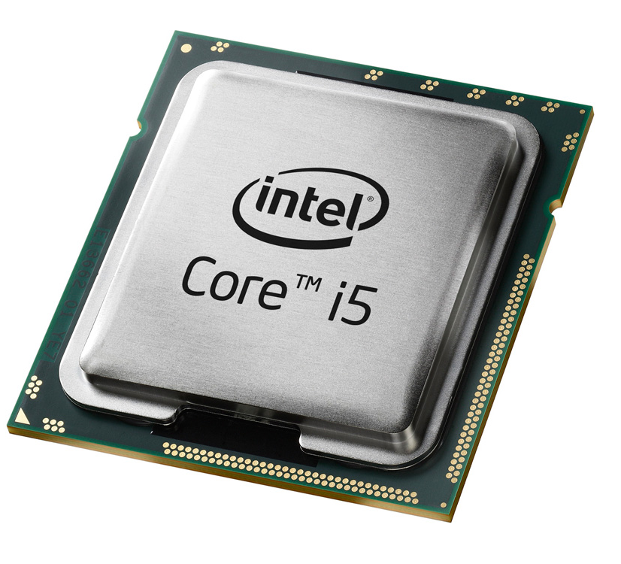
Goals
To create, in x86 Assembler, an operational version of the classical game of snake, using only ASCII characters to denote important game pieces.
Such as:
Snake
Food
Boarders of game board
Tail Segments of the Snake

Slide 3

Design
We used procedures to mainly generate the elements of our program.
The procedure calls are then made in main.
Basically a series of functions to execute the several conditional checks and display parameters.

Slide 4

Demo:
Here we have a cool demo!

Slide 5

Lessons Learned
How to better use Irvine32 library
How to use jumps and conditionals
How to implement procedures and loops with jumps
How to interpret and fix errors
How to use simple macros

Slide 6

What we would do in the future
Sometimes the Snake starts on the edge so fixing that bug would need to happen.
We would add an option to play again.
We would fix a bug that does not allow the Snake to turn around and reverse direction.
We would fix a bug to even out the speed for the Snake in all directions
We would fix a bug where random movements end the game for no reason.
We would add a menu to the start of the game and have different “levels” of the game. This is something we planned but could not implement.

